Slide 1
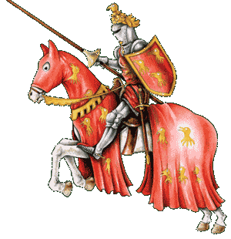
Knights and Castles

Slide 2
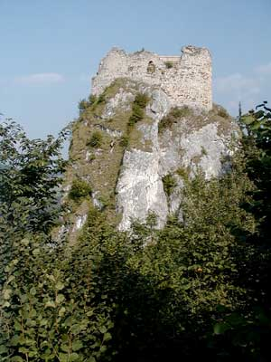
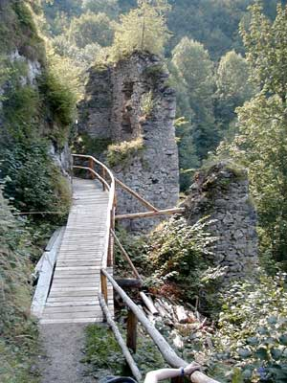
Eppenstein Ruins
Liutold came from the Eppensteiner family. The shortened form of Liutold was Judin and so Judenburg got its name.
Eppenstein was one of the oldest castles. (in 1000)

Slide 3
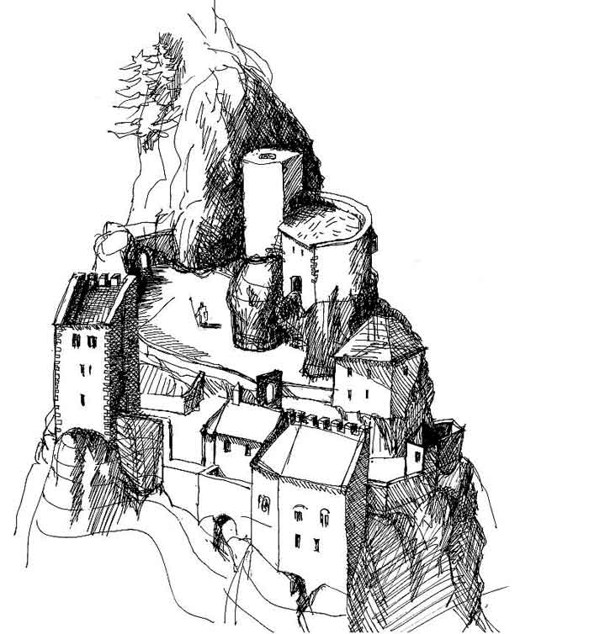
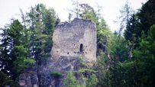
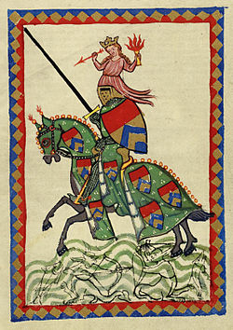
Lichtenstein Ruins
Ulrich von Liechtenstein was born in 1200 and died in 1275. He was a singing minstrel, poet and knight from the Middle Ages.

Slide 4
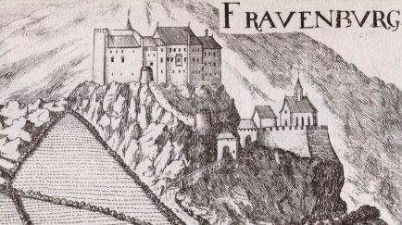
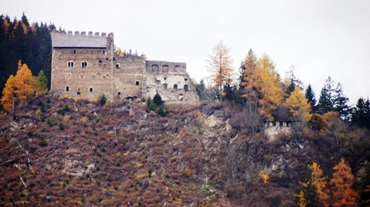
Frauenburg
Frauenburg lies on a mountain. It was built in 1248. Ulrich von Liechtenstein inherited it from his father.

Slide 5
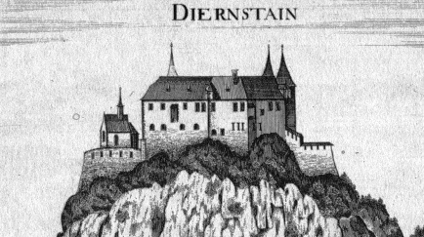
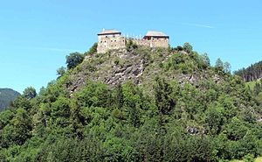
Dürnstein Ruin
Another example is Dürnstein ruin which was built in the 11th century.

Slide 6
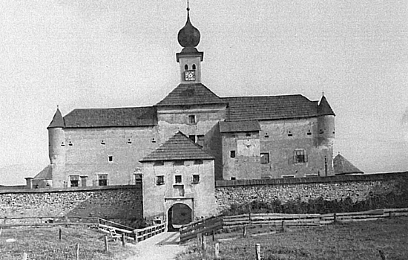
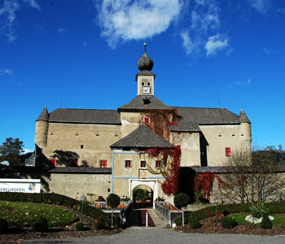
Castle Gabelhofen
It used to be a water castle. Now a days it is a 4 star hotel.

Slide 7
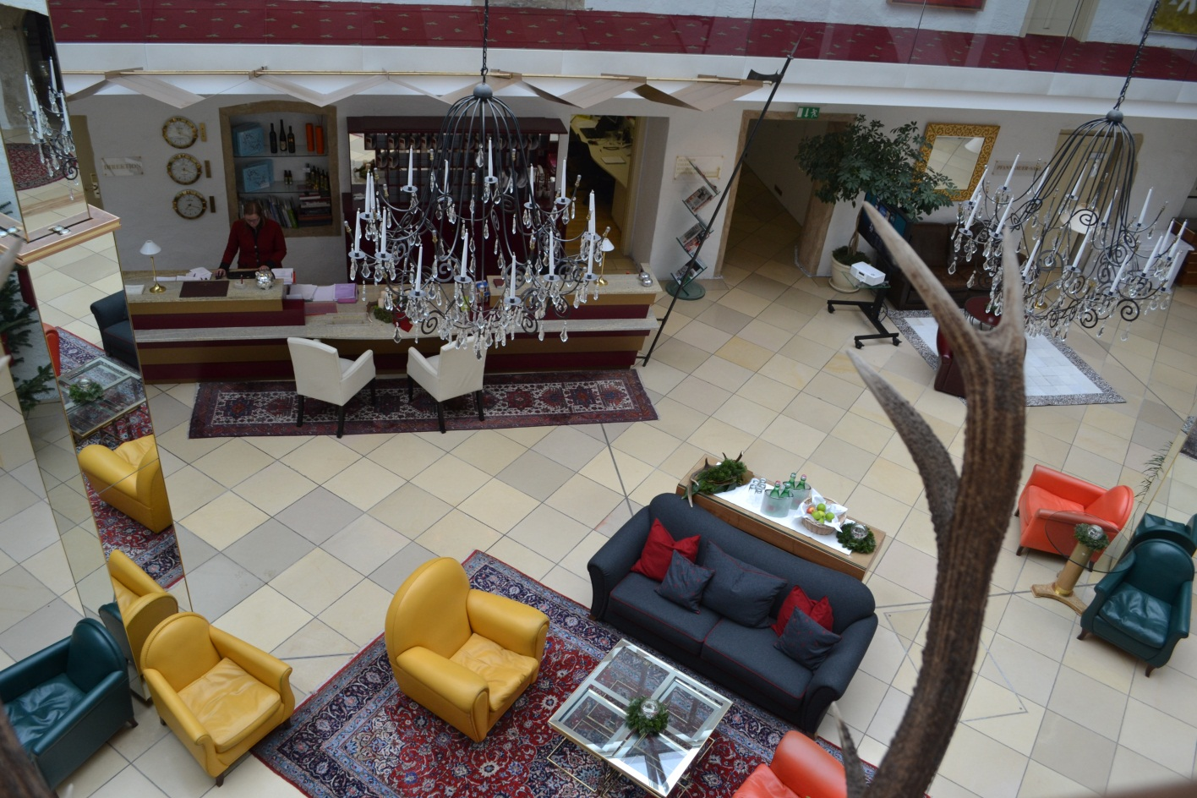
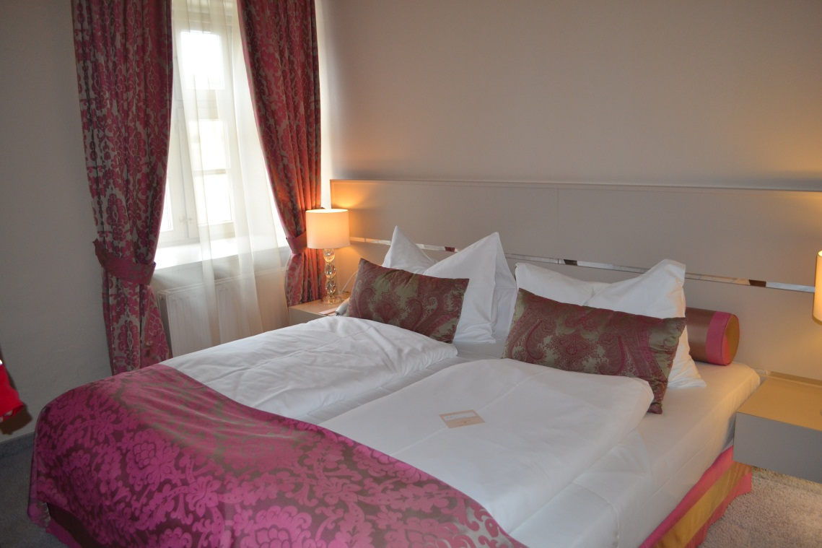
Castle Gabelhofen
NOW

Slide 8
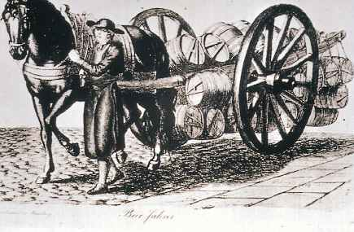
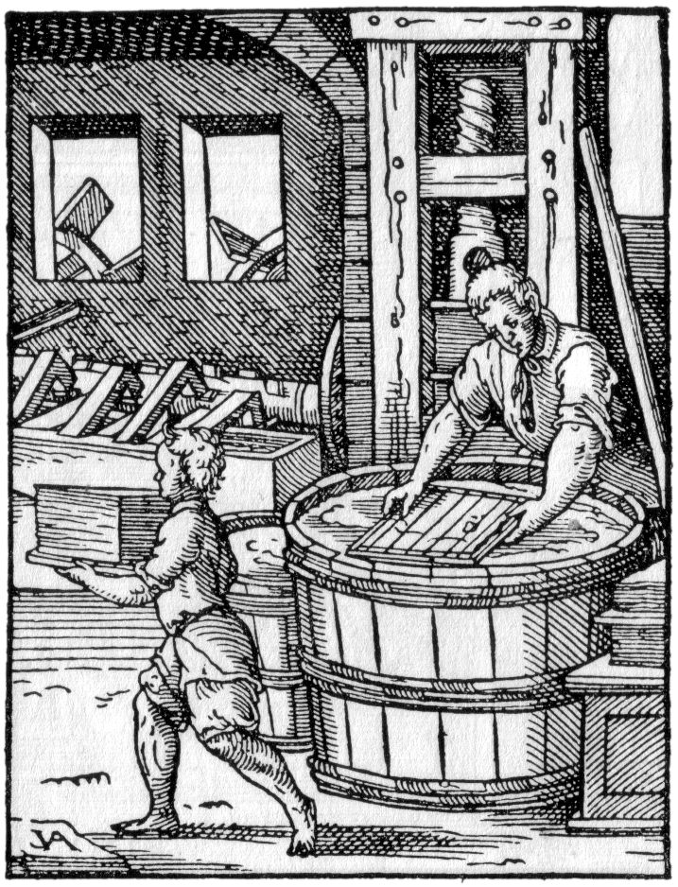
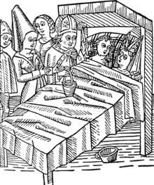
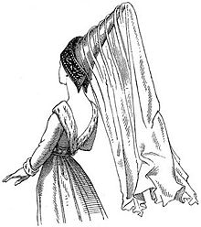
Life in the Middle Ages

Slide 9
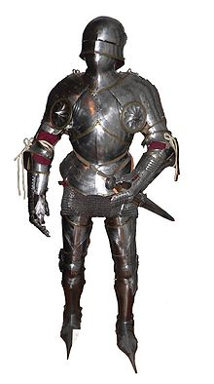
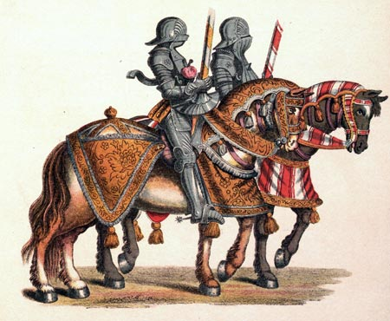
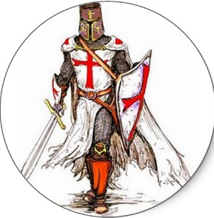

Slide 10
In the castle life was very lonely and isolated.

